Slide 1
Chapter four
INPUT MODELING

Slide 2
INPUT MODELING
Input models provide the driving force for a simulation model.
There are four steps in the development of a useful model of input data:
Collect data from the real system.
Identify a probability distribution to represent the input process.
Choose parameters that determine specific instance of the distribution family.
Evaluate the chosen distribution and the associated parameters for goodness of fit.
Goodness-of-fit may be evaluated informally via graphical methods, or formally via statistical tests.
The chi-square and the Kolmogorov-Smirnov tests are standard goodness-of-fit tests.

Slide 3
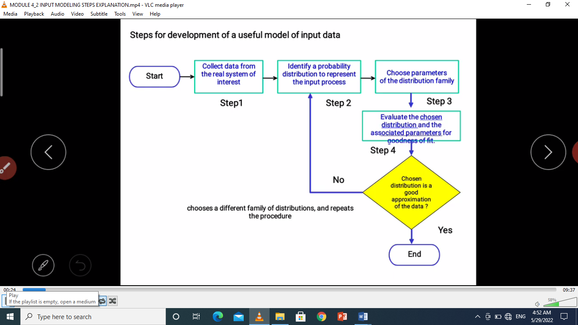
Conti…

Slide 4
1. Data Collection
One of the biggest tasks in solving a real problem is data collection.
GIGO – garbage-in-garbage-out.
Suggestions that may enhance and facilitate data collection:
Plan ahead: begin by a practice or pre-observing session, try to collect pre-observing data.
Analyze the data as it is being collected: check adequacy.
Combine homogeneous data sets.
Be aware of data censoring: the quantity is not observed in its entirety, danger of leaving out long process times.
Check for relationship between variables, e.g. build scatter diagram
Collect input data, not performance data(output data).

Slide 5
2. Identifying the Distribution with Data
Histogram
A frequency distribution or histogram is useful in identifying the shape of a distribution.
A histogram is constructed as follows:
Divide the range of the data into intervals
Label intervals selected on horizontal axis.
Determine the frequency of occurrences within each interval.
Label the frequencies on the vertical axis.
Plot the frequency of occurrences for each interval.

Slide 6
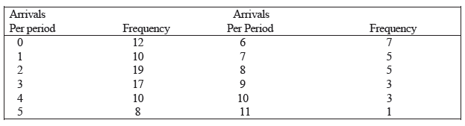
Conti…

Slide 7
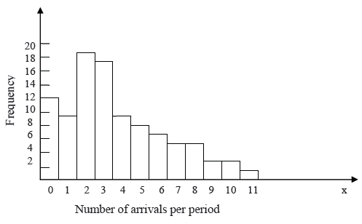
Fig 4.1 Histogram of number of arrivals per period

Slide 8
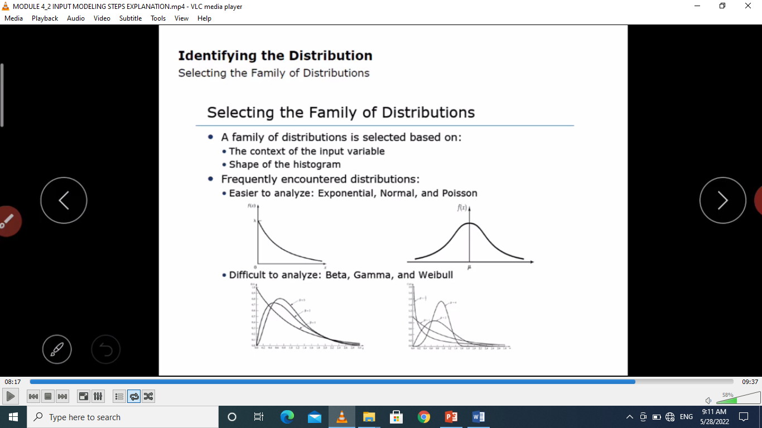
Selecting the Family of Distributions
Family of distributions is selected on the basis of what might arise in the context being investigated along with the shape of the histogram.

Slide 9
Conti…..
Here are some examples:
I. Binomial: Models the number of successes in ‘n’ trials, when the trials are independent with common success probability p.
For example, the number of defective computer chips found in a lot of ‘n’ chips.
II. Poisson: Models the number of independent events that occur in a fixed amount of time or space.

Slide 10
Conti…..
iii. Normal: Models the distribution of a process that can be thought as the sum of individual component processes.
For example, the time to assemble a product, which is the sum of the times required for each assembly operation.
iv. Lognormal: Models the distribution of a process that can be thought of as the product of a number of component processes.
v. Exponential: Models the time between independent events, or a process.
e.g. The time between arrival of large number of customer.

Slide 11
Conti…..
viii. Beta: An extremely flexible distribution used to model bounded (fixed upper and lower limits) random variables.
x. Weibull: Models the time to failure of components; for example, the time to failure for a disk drive.
xi. Triangular : Models a process when only the minimum, most-likely, and maximum values of the distribution are known.
For example, the minimum, most likely, and maximum time required testing a product.

Slide 12


3. Parameter Estimation
After a family of distributions has been selected, the next step is to estimate the parameters of the distribution.
In a number of instances, the sample mean and sample variance, are used to estimate of the parameters of hypothesized distribution.
If the observations in a sample of size n, are X₁, X₂,..., X_{n}, the sample mean is defined by :-
And the sample variance, s² is defined by:-

Slide 13


Conti…
If the data are discrete and grouped in frequency distribution, the previous formula is modified like given below.
Sample mean can be computed by :-
And the sample variance by:-
where f_{j} is the observed frequency of value X_{j.}
Example (for grouped data):-Vehicle Arrival in the histogram example
on the following table can be analyzed to obtain: The sample mean and variance are:-

Slide 14
Conti…
The sample standard deviation S is just the square root
of the sample variance in this case S = 7.63= 2.76.

Slide 15
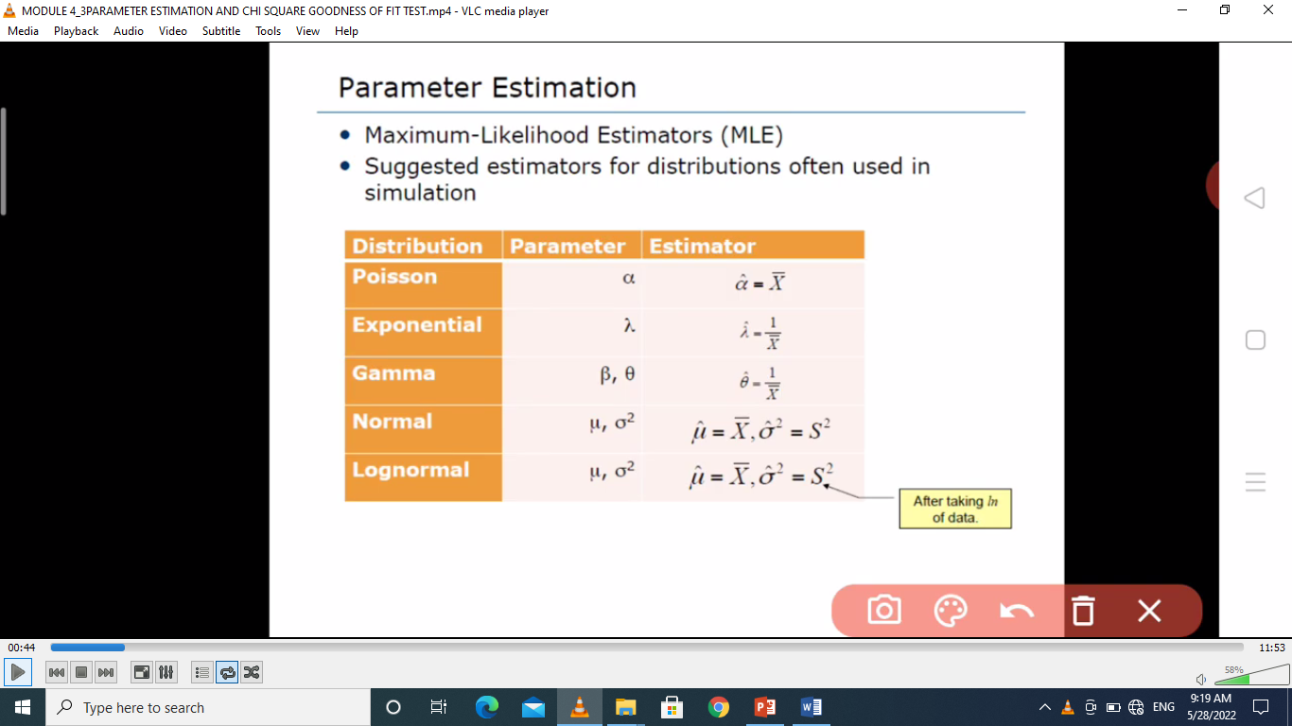
Suggested estimator

Slide 16
4. Goodness-of-Fit Tests
Goodness-of-fit tests provide full guidance for evaluating the suitability of a potential input model.
Used to determine whether the distribution is good representation of the data or not.
Conduct hypothesis testing on input data distribution using:-
Kolmogorov-Smirnov test
Chi-square test

Slide 17
Thank You?

